Slide 1
Lessons to be learned and key areas for action from the 2015 Perinatal Confidential Enquiry

Slide 2
Key areas for action

Slide 4
Key Findings

Slide 5
Key findings

Slide 6
Key areas for action - ANC

Slide 7
Key areas for action - ANC

Slide 8
Key areas for action - ANC

Slide 10
Key findings

Slide 11
Key findings

Slide 12
Key findings

Slide 13
Key areas for action – care following SB

Slide 14
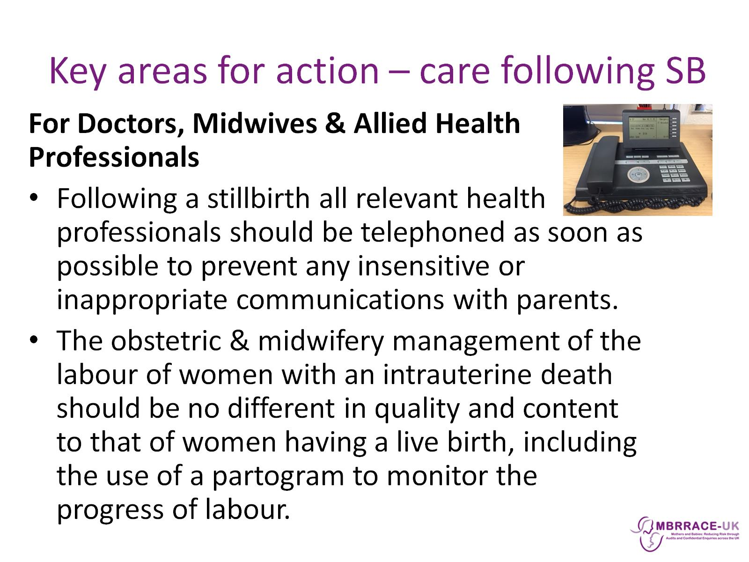
Key areas for action – care following SB

Slide 16
Key findings

Slide 17
Key findings

Slide 18
Key Findings

Slide 19
Key areas for action – care after birth

Slide 20
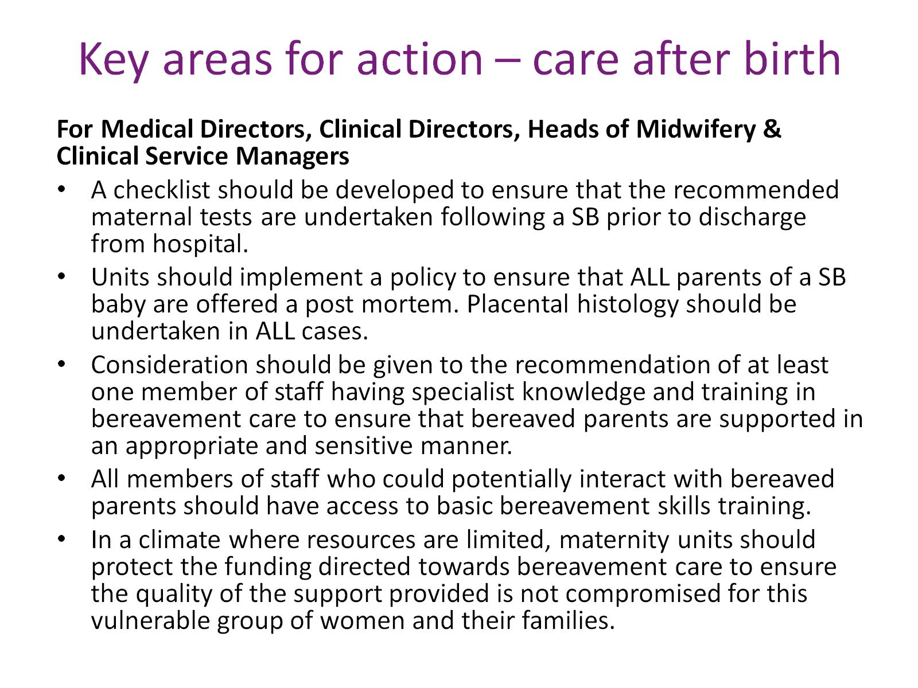
Key areas for action – care after birth

Slide 22
Key findings

Slide 23
Key findings

Slide 24
Key findings

Slide 25
Key findings

Slide 26
Key areas for action – follow-up care and review

Slide 27
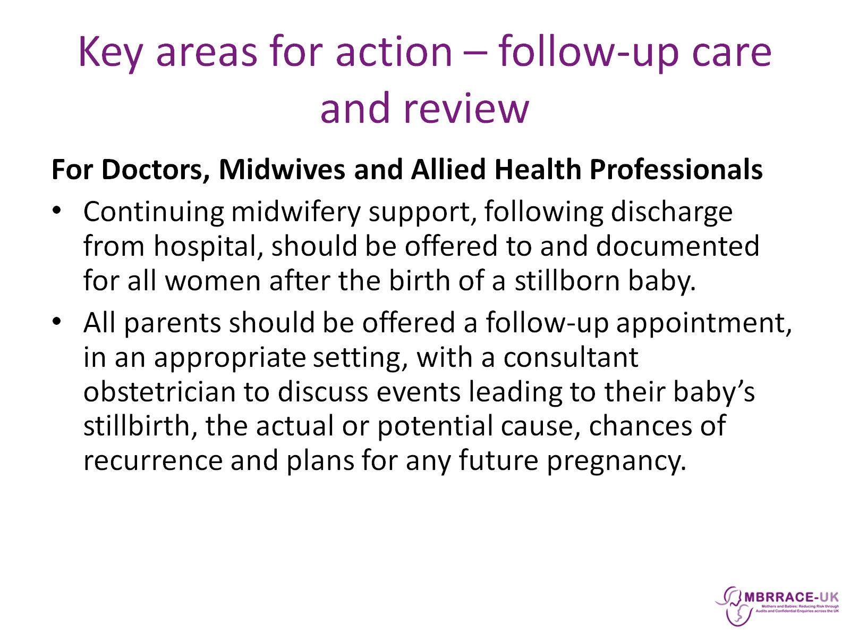
Key areas for action – follow-up care and review

Slide 29
Key findings

Slide 30
Key findings

Slide 31
Key areas for action – pathology & histology

Slide 33
Key findings

Slide 34
Key findings

Slide 35
Key areas for action – communication

