Slide 1
Communication Issues

Slide 2
Background

Slide 3
Background

Slide 4
Listening to parents report - NPEU

Slide 5
Parents with complex social needs

Slide 7
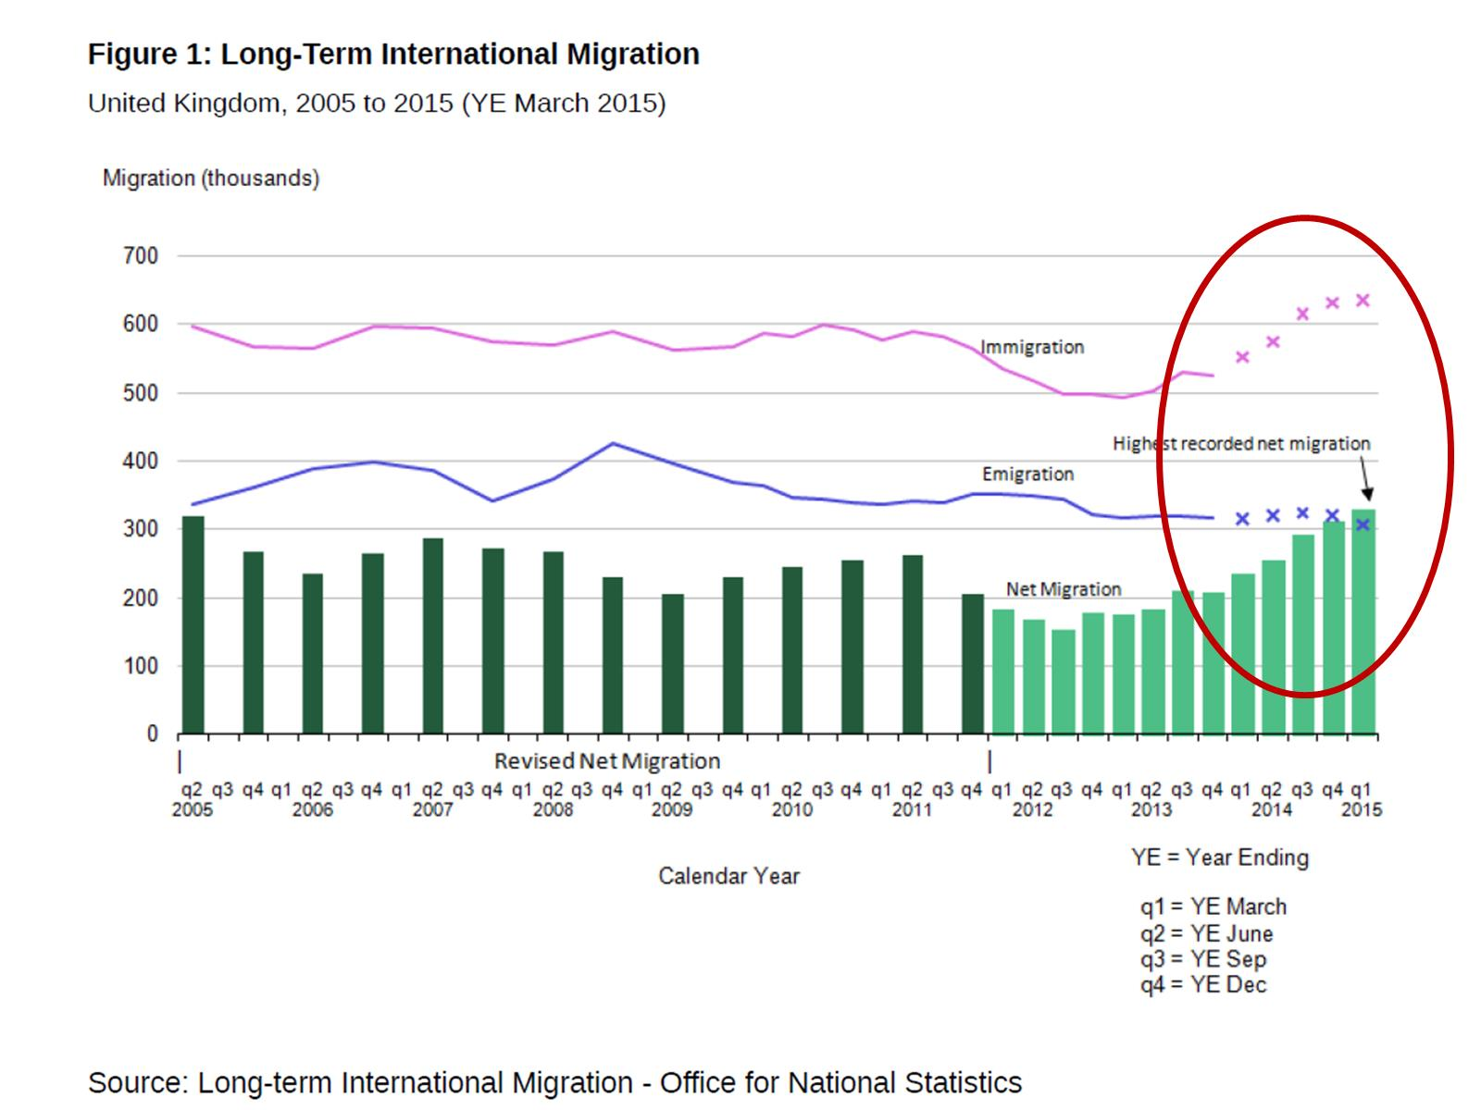

Slide 8
Parents with complex social needs

Slide 9
Guidelines & standards relating to communication and documentation issues for antepartum stillbirth

Slide 10
Summary of communication findings from panels

Slide 11
Language difficulties and interpreting services

Slide 13
Language difficulties and interpreting services

Slide 14
Language difficulties and interpreting services

Slide 15
Issues with record keeping

Slide 16
Communication between health care professionals and parents

Slide 17
Interactions with parents

Slide 19
Lack of evidence

Slide 20
Conclusion

