Slide 1
Results from the 2015 Perinatal Confidential Enquiry

Slide 2
Stillbirths – how often in the UK?

Slide 4
Sampling of cases for APSB enquiry

Slide 5
Was the sample of term, singleton, normally formed, antepartum stillbirths selected for enquiry representative of all such cases in 2013?

Slide 6
Maternal age

Slide 7
Ethnicity

Slide 8
Region / Country of residence

Slide 9
Deprivation

Slide 10
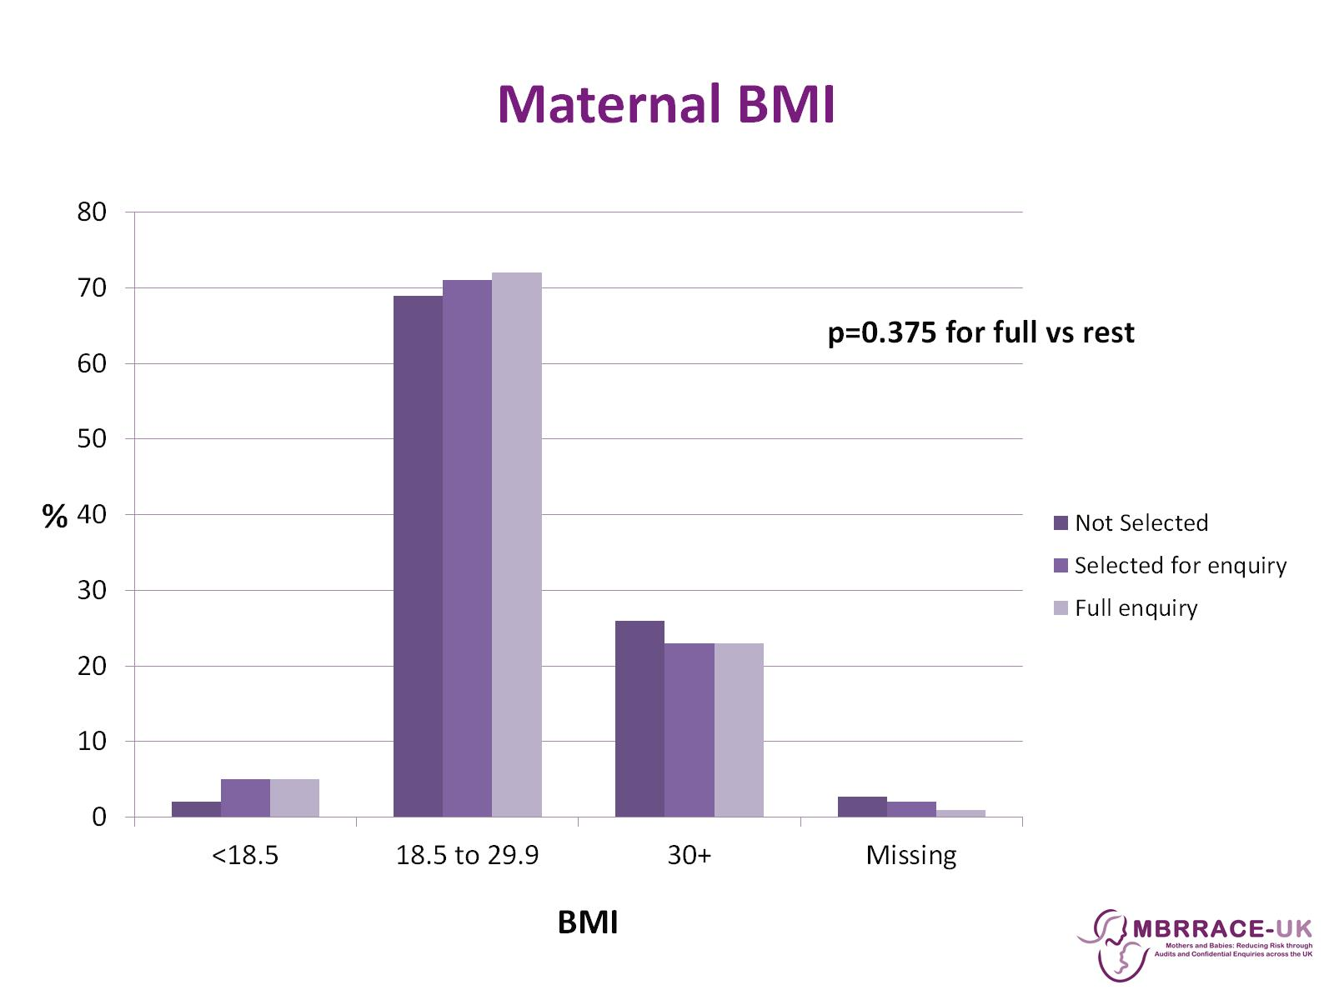
Maternal BMI

Slide 11
Previous pregnancies

Slide 12
Smoking status

Slide 13
Employment status

Slide 14
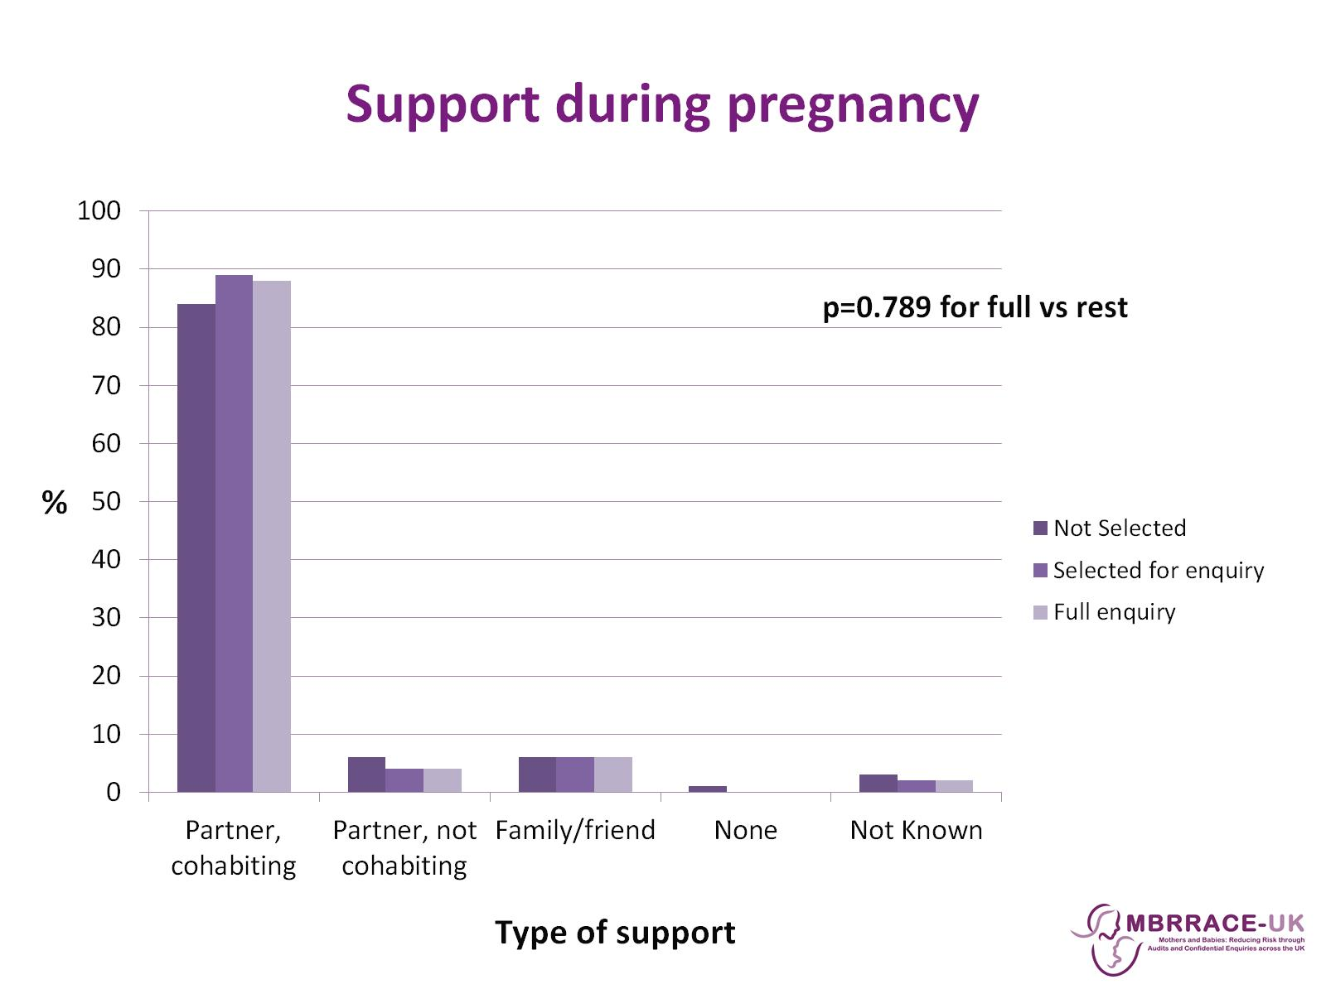
Support during pregnancy

Slide 15
Gestation at first booking

Slide 16
Post mortem

Slide 17
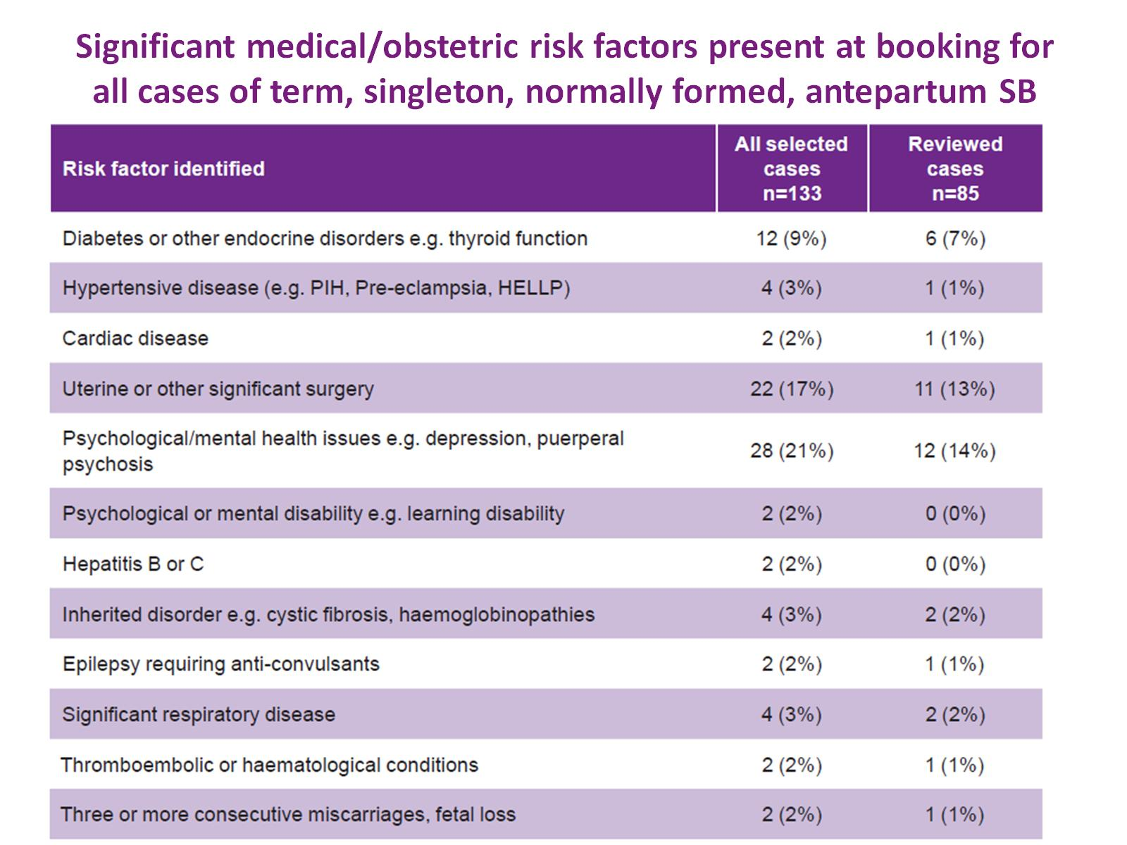
Significant medical/obstetric risk factors present at booking for all cases of term, singleton, normally formed, antepartum SB

Slide 18
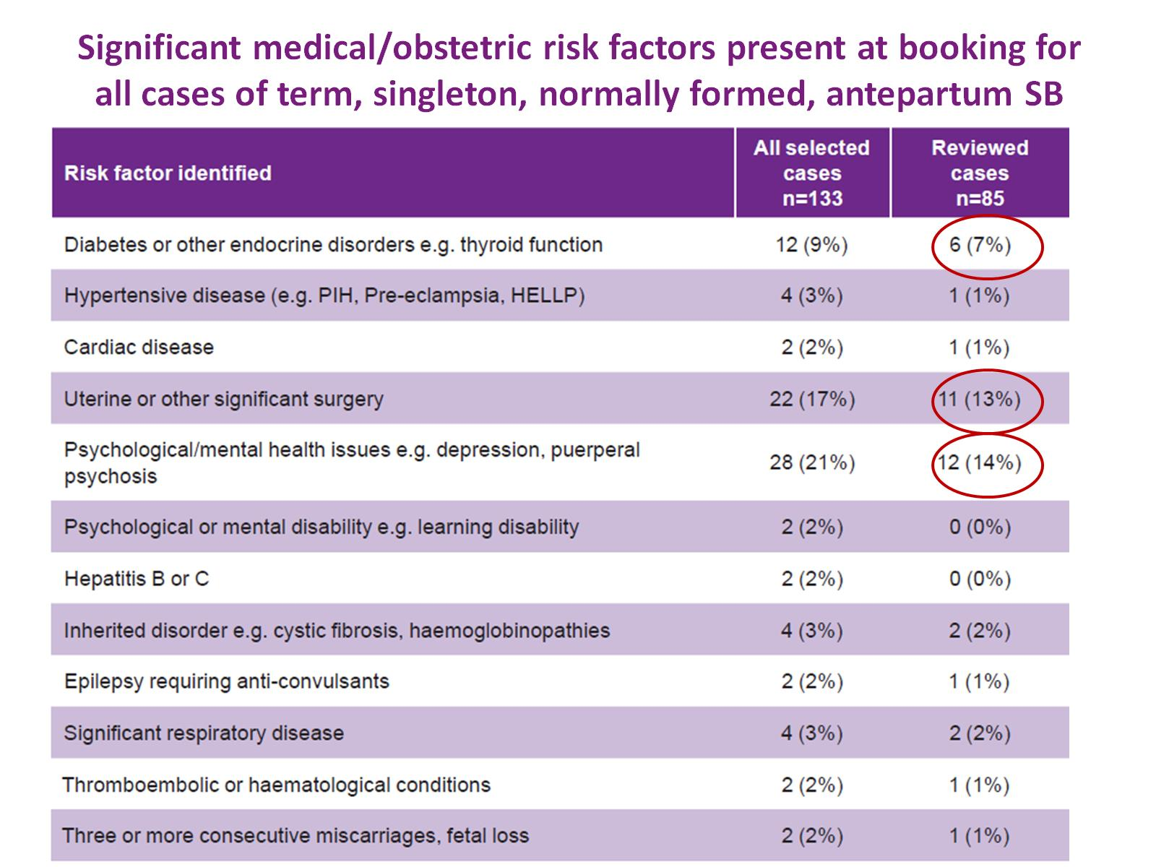
Significant medical/obstetric risk factors present at booking for all cases of term, singleton, normally formed, antepartum SB

Slide 19
Obstetric risk factors from a previous pregnancy identified in the term, singleton, normally formed, antepartum SBs

Slide 20
Obstetric risk factors from a previous pregnancy identified in the term, singleton, normally formed, antepartum SBs

Slide 21
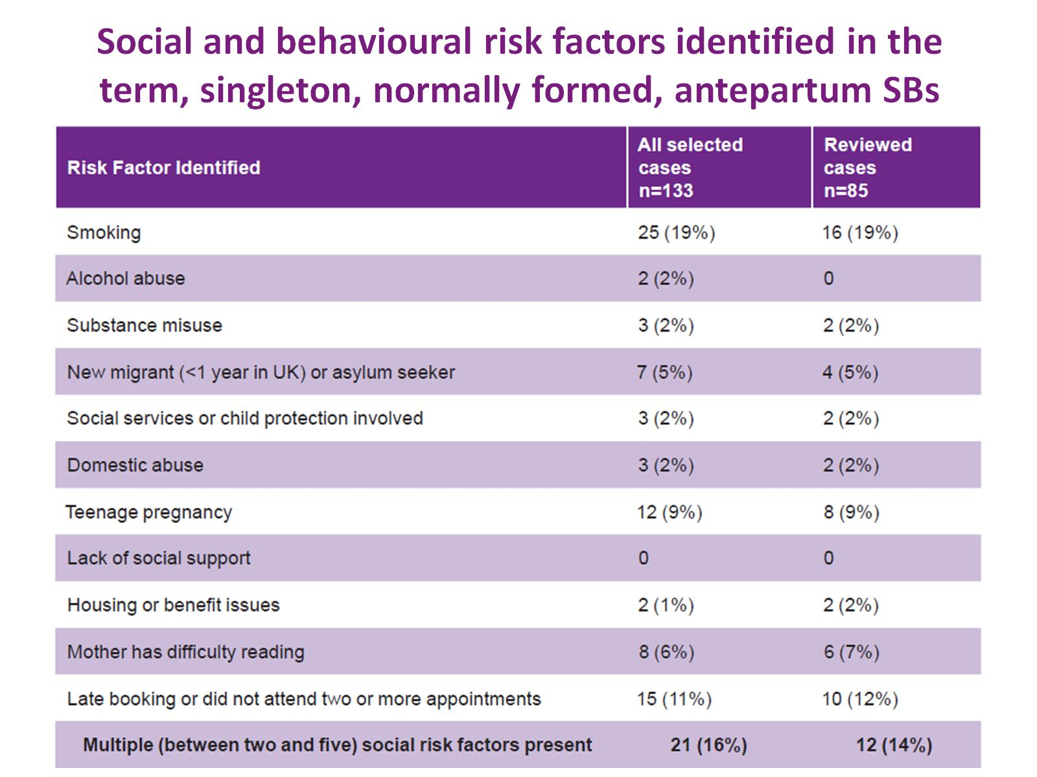
Social and behavioural risk factors identified in the term, singleton, normally formed, antepartum SBs

Slide 22
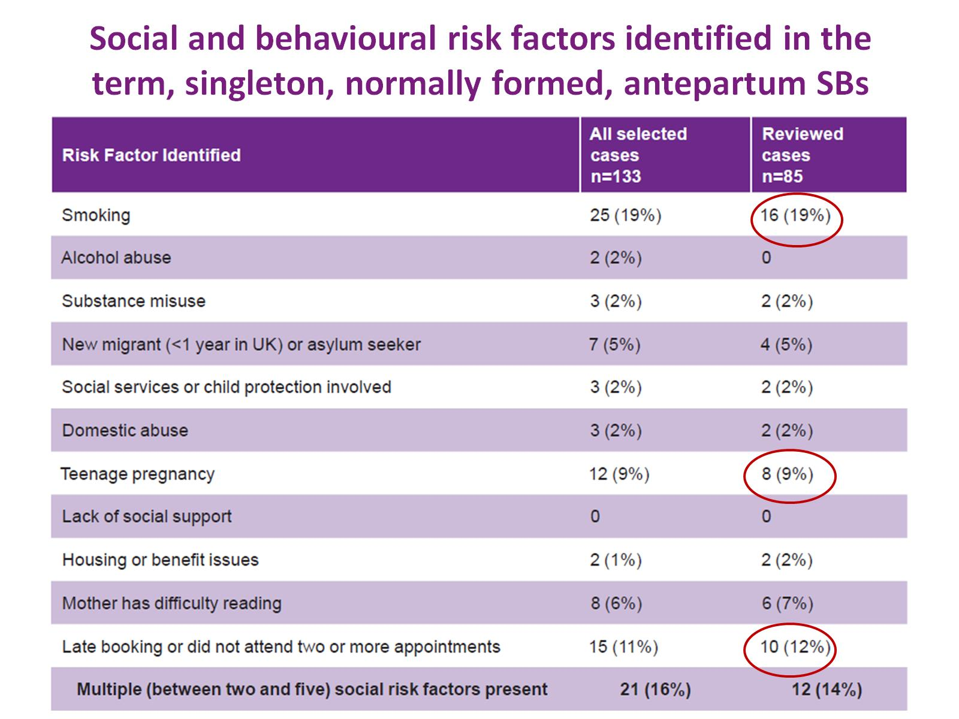
Social and behavioural risk factors identified in the term, singleton, normally formed, antepartum SBs

Slide 23
Risk factors for developing maternal gestational diabetes

Slide 24
Risk factors for developing maternal gestational diabetes

Slide 25
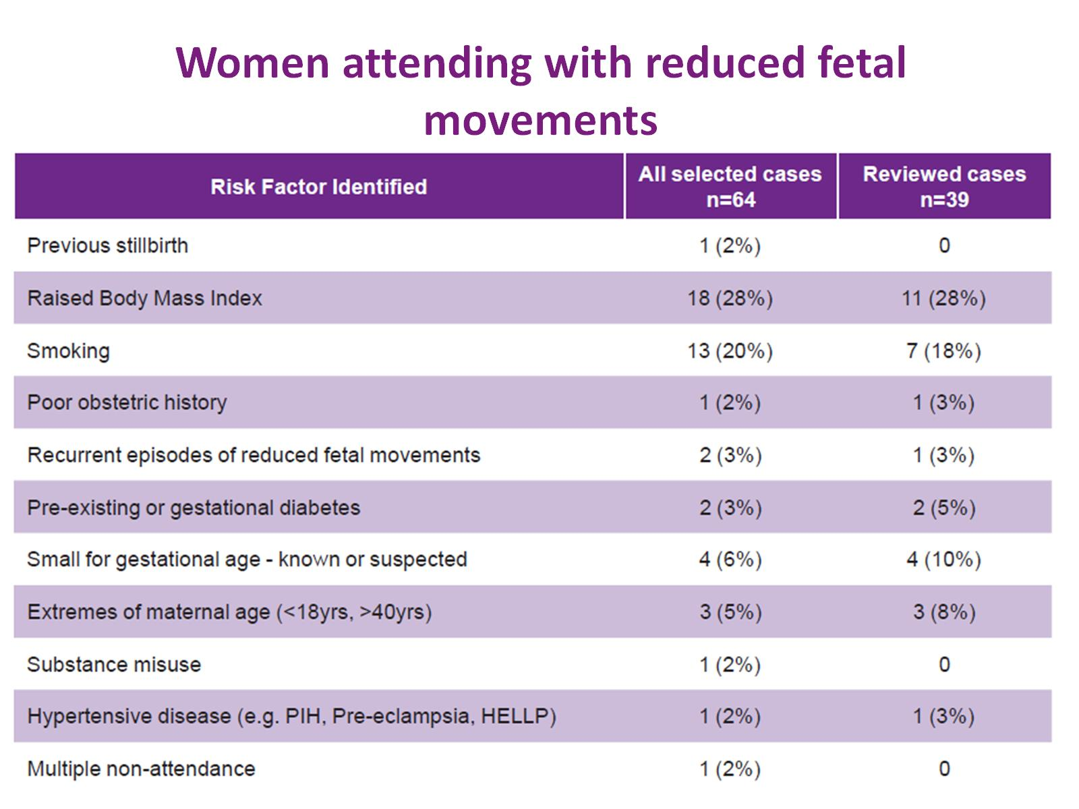
Women attending with reduced fetal movements

Slide 26
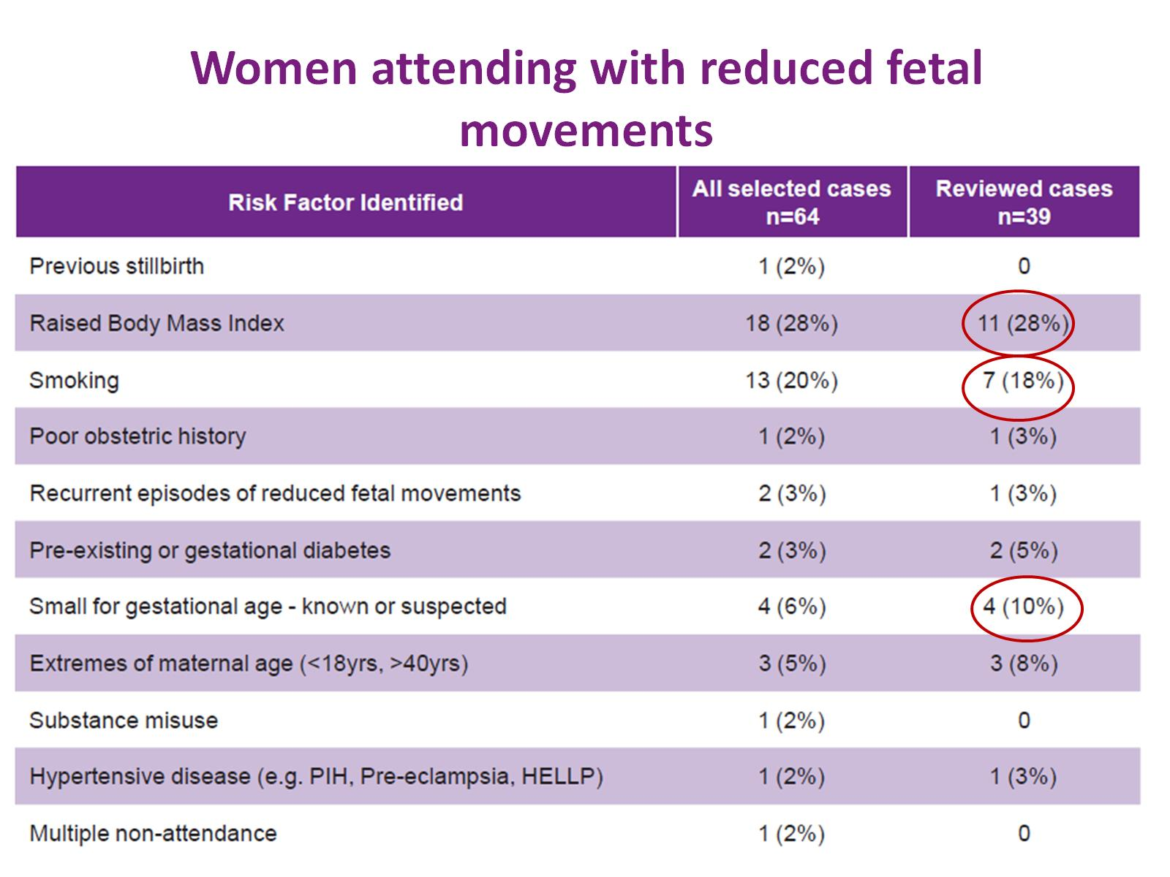
Women attending with reduced fetal movements

Slide 27
Confidential enquiry summary grading of quality of care

Slide 28
Confidential enquiry summary grading of quality of care

Slide 29
Confidential enquiry poorest grading of quality of care by point on the care pathway for each case

Slide 30
Confidential enquiry poorest grading of quality of care by point on the care pathway for each case

Slide 31
Confidential enquiry poorest grading of quality of care by point on the care pathway for each case

Slide 32
Confidential enquiry poorest grading of quality of care by point on the care pathway for each case

Slide 33
Confidential enquiry poorest grading of quality of care by point on the care pathway for each case

Slide 34
Confidential enquiry poorest grading of quality of care by point on the care pathway for each case

Slide 35
Confidential enquiry poorest grading of quality of care by point on the care pathway for each case

