Slide 1
MBRRACE-UK Perinatal Confidential Enquiry 2015 Term, Singleton, Normally-formed, Antepartum Stillbirth

Slide 2
Maternal, Newborn and Infant Clinical Outcome Review Programme

Slide 3
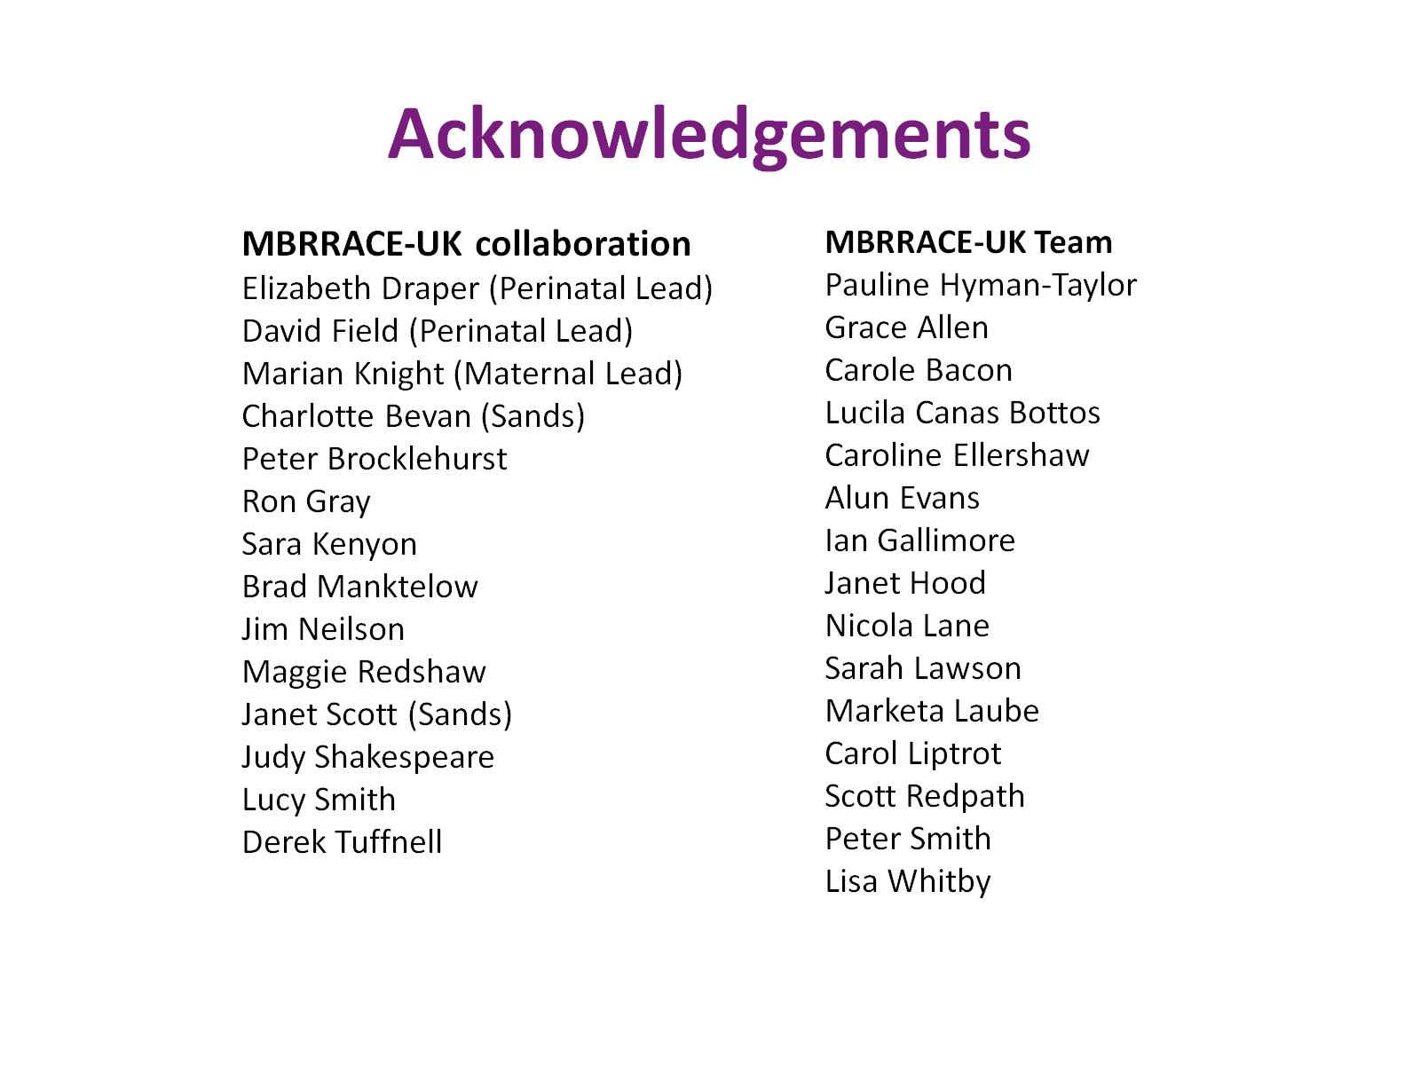
Acknowledgements

Slide 4
Acknowledgements

Slide 5
Acknowledgements

Slide 6
Acknowledgements

Slide 7
Acknowledgements

Slide 8
Acknowledgements

Slide 9
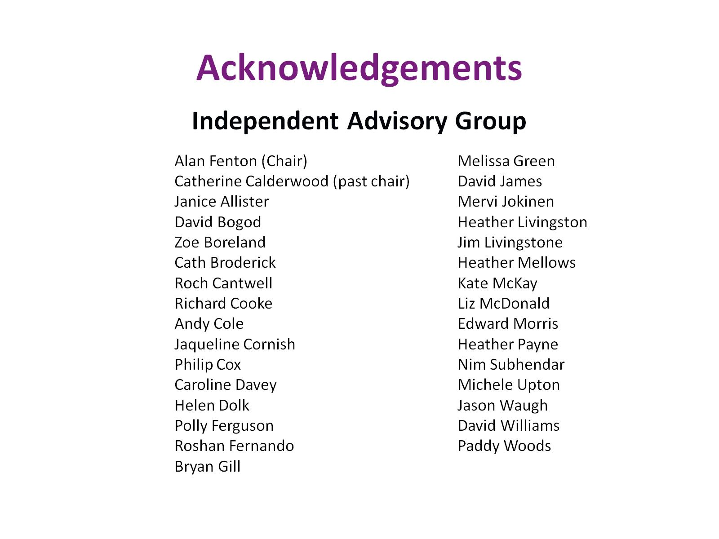
Acknowledgements

Slide 10
Acknowledgements

Slide 11
Funding

Slide 12
Twitter

