Slide 1
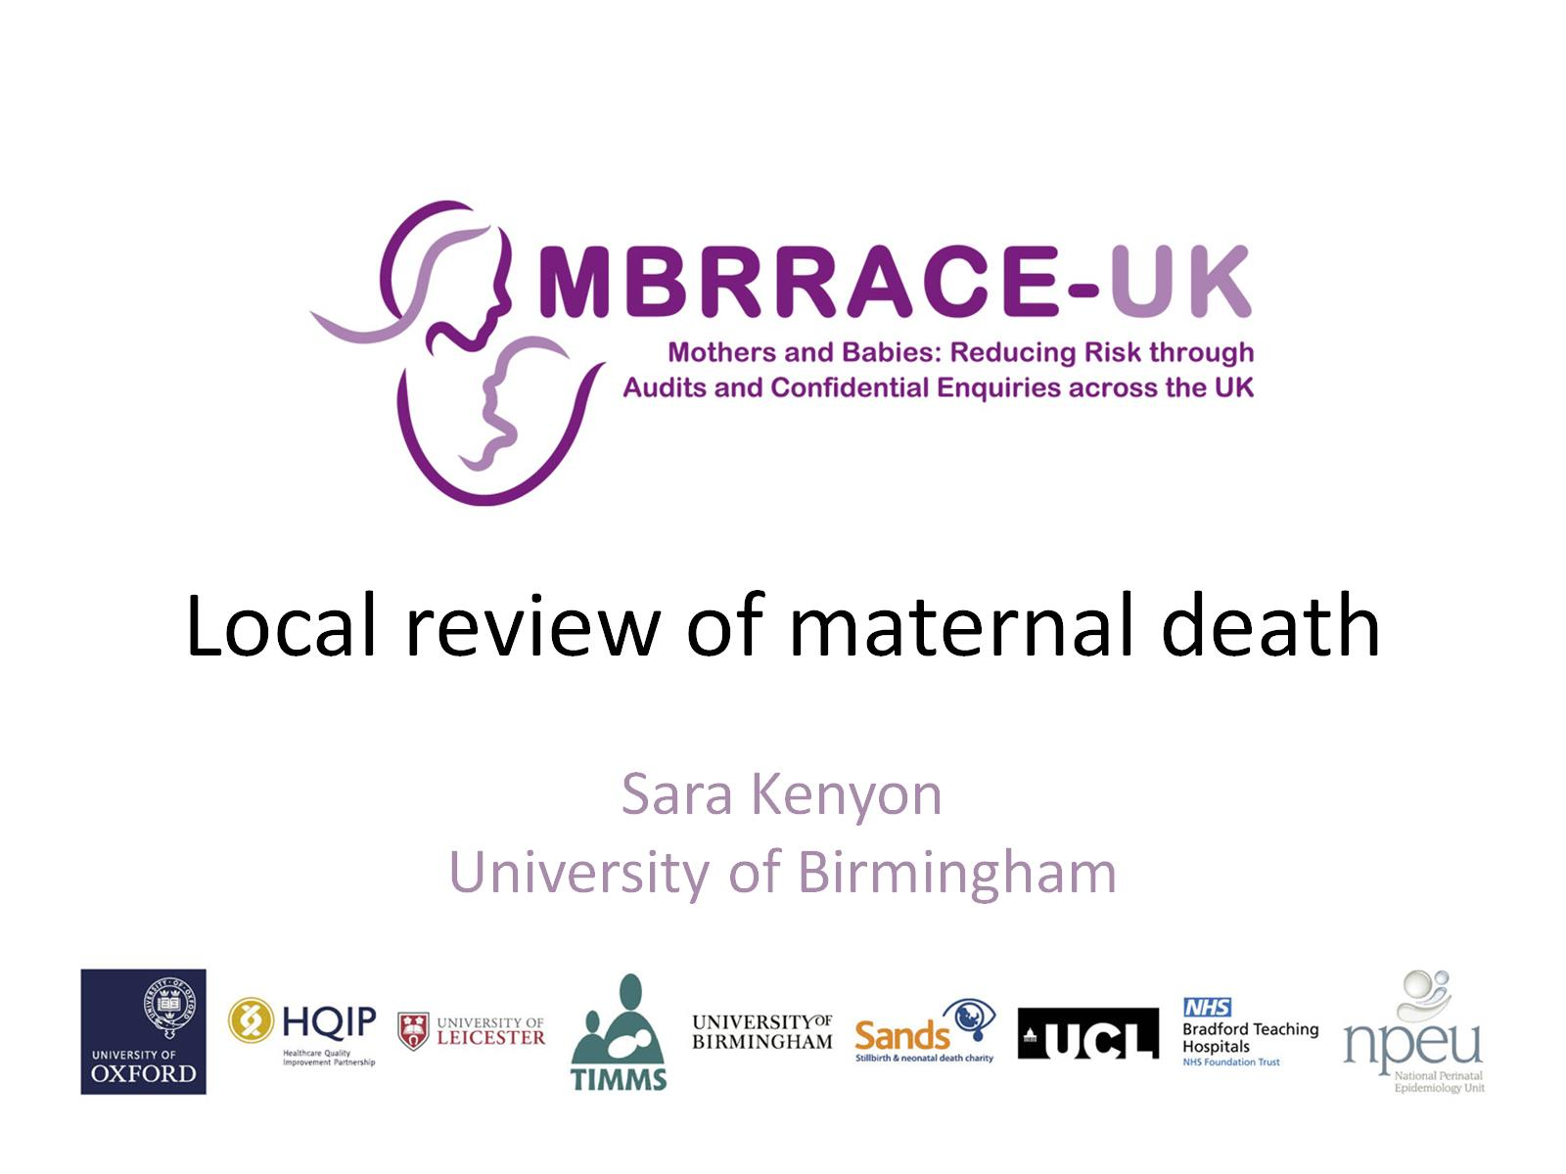
Local review of maternal death

Slide 2
Learning lessons to improve care

Slide 4
What is the purpose of local review?

Slide 5
What should the review include?

Slide 6
Local clinician reports

Slide 7
Do we undertake review of care in all cases?

Slide 8
Multidisciplinary review

Slide 9
Vignette (2014)

Slide 10
Vignette

Slide 11
Review of late maternal death

Slide 12
Evidence from the MBRRACE-UK antepartum term stillbirth confidential enquiry

Slide 14
Results

Slide 15
Quality of the review

Slide 16
Learning lessons to improve care

Slide 18
Recommendation 23 from the Kirkup report

