Slide 1
Background & development of the 2013 Perinatal Confidential Enquiry into CDH

Slide 2
Background

Slide 3
Background

Slide 4
Aims of the MBRRACE-UK confidential enquiries:

Slide 5
Choice of Confidential Enquiry topic

Slide 6
MBRRACE-UK CE Topics

Slide 8
Topic choice for 2013: Congenital diaphragmatic hernia

Slide 9
Information sources

Slide 10
What is CDH?

Slide 11
Congenital diaphragmatic hernia

Slide 12
Epidemiology of CDH

Slide 13
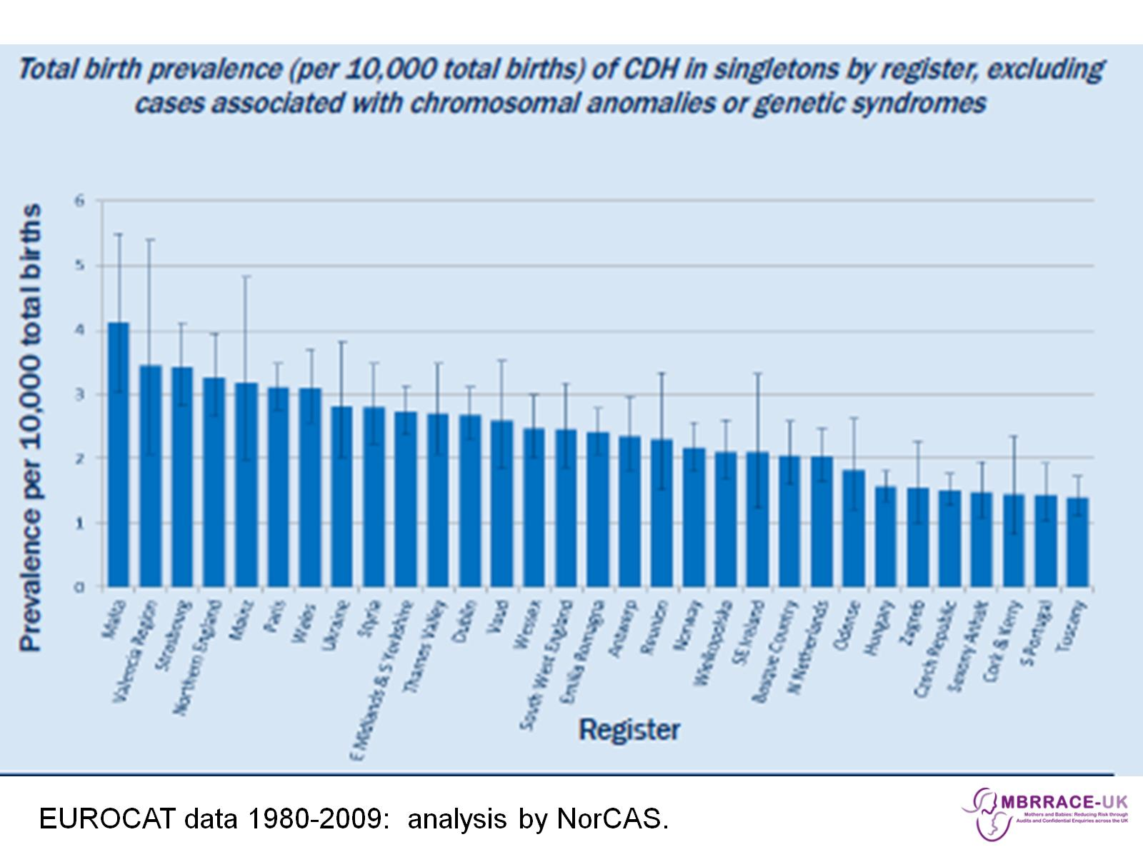

Slide 14
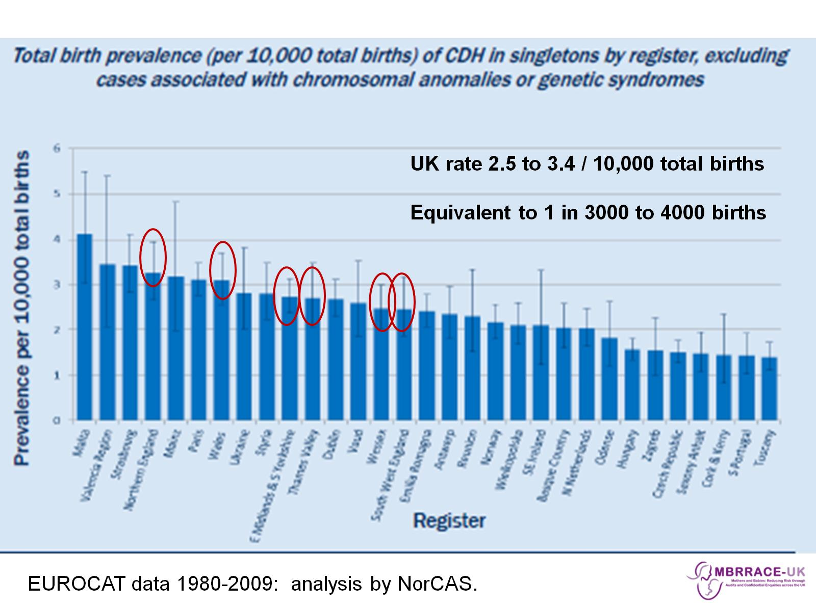

Slide 15
Epidemiology of CDH

Slide 17
Epidemiology of CDH

Slide 18
Specific aims of the CDH enquiry

Slide 19
Topic Expert Group & Panel membership

Slide 20
Topic Expert Group - remit

Slide 21
CDH care pathway

Slide 22
CDH care pathway cont:

Slide 23
Diagnosis & screening:

Slide 24
Diagnosis, screening & delivery:

Slide 25
CDH care pathway cont:

Slide 26
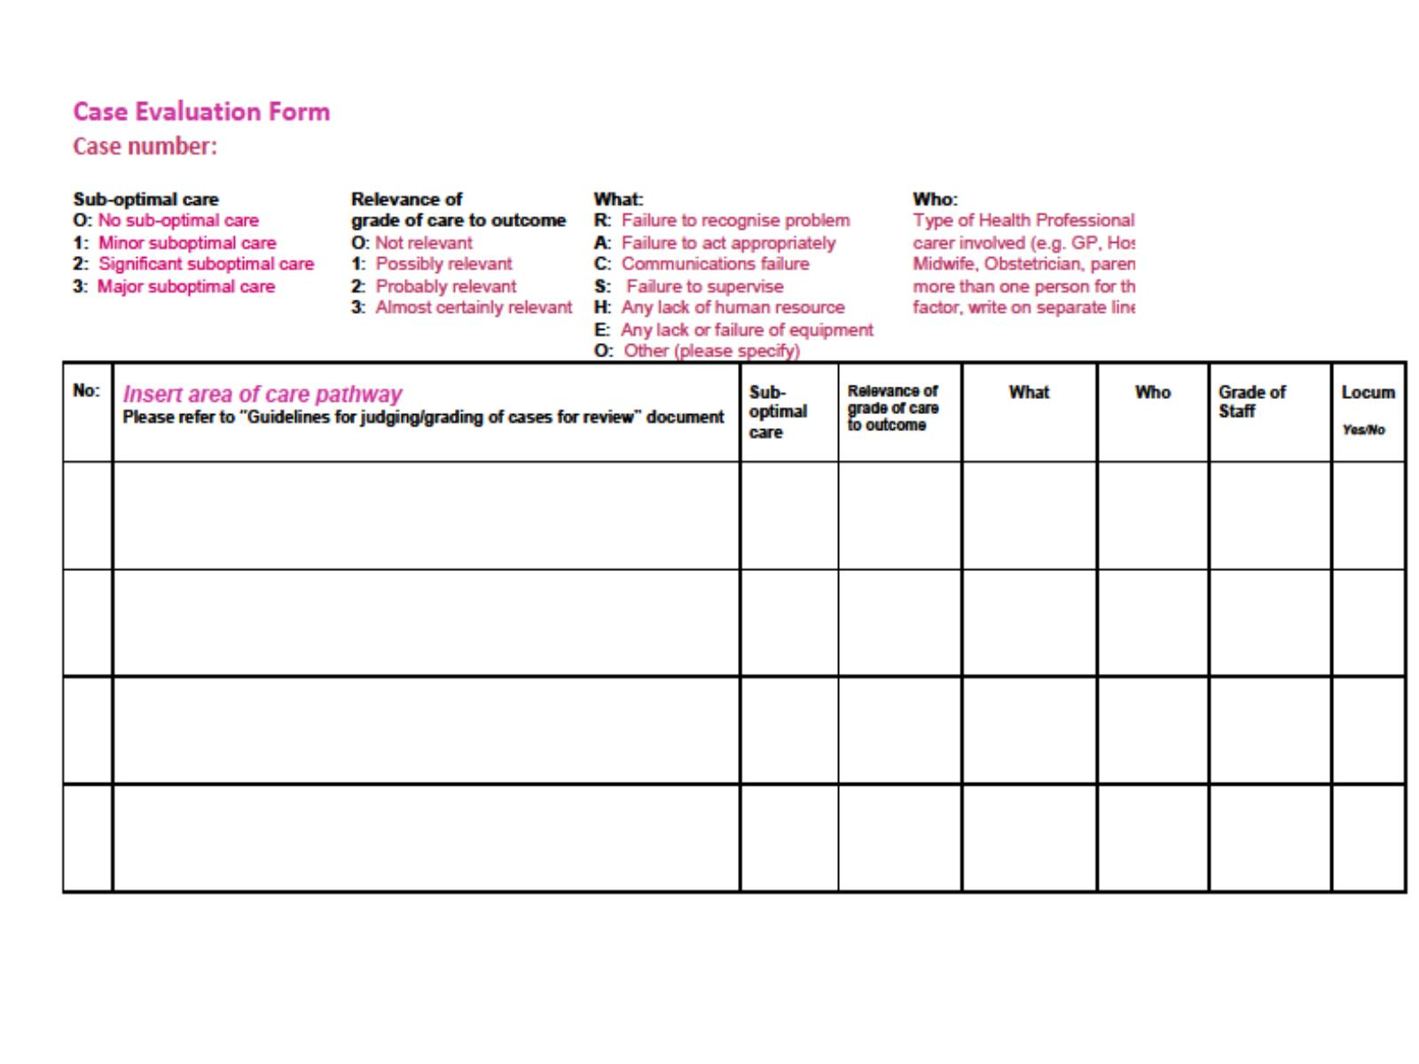

Slide 27
Evaluation of Care

Slide 28
CDH panel enquiry process

Slide 29
Acquiring case notes

Slide 30
Preparation for panel meetings

Slide 31
CDH panel meetings

