Slide 1
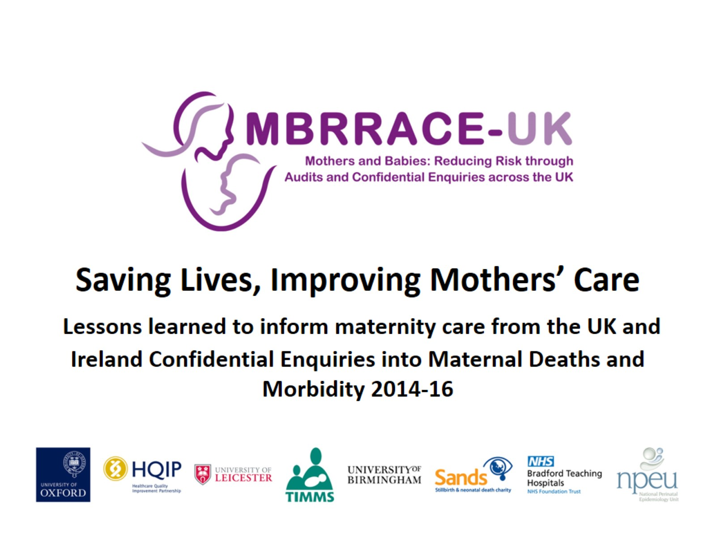
Saving Lives, Improving Mothers’ Care Lessons learned to inform maternity care from the UK and Ireland Confidential Enquiries into Maternal Deaths and Morbidity 2014-16

Slide 2
Acknowledgements

Slide 3
Acknowledgements

Slide 4
Acknowledgements

Slide 5
Acknowledgements

Slide 6
Acknowledgements

Slide 7
Acknowledgements

Slide 8
Acknowledgements

Slide 9
Funding

